Slide 1

PREDICTION OF THE QUANTITY OF PRODUCTS SOLD IN A SUPERMARKET
CASE STUDY- Ocean Supermarket, Myanmar.
BRANCHES: Mandalay, Nay Pyi Taw and Yangon.
http://www.oceansupercenter.com.mm/

Slide 2
PROBLEM STATEMENT AND AIM
PROBLEM STATEMENT
Mr. Bonner the owner of Ocean’s supermarket, complained of constant expiration of his goods in his supermarket which he confirmed was caused by overstocking which has frequently led to losses. Hence, he desired a solution to guide him on stocking.
AIM
This Project is aimed at predicting the quantity of goods to be purchased in each day of the first quarter of subsequent years. This is achieved by using the model that best yields approximately the same Quantities as in the Sales record/Dataset for each transaction in the first quarter of 2019.

Slide 3
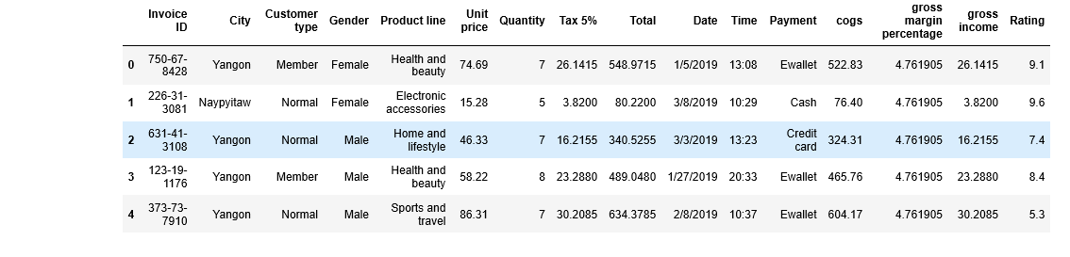
DATASET ON THE SALES RECORD

Slide 4
UNDERSTANDING TERMS
Gross Income
Gross income for an individual
This is also known as gross pay, is the individual's total pay from his employer before taxes or other deductions. This includes income from all sources and is not limited to income received in cash, but it can also include property or services received. Gross annual income is the amount of money a person earns in one year before taxes.
For companies
Gross income is interchangeable with gross margin or gross profit. A company's gross income, found on the income statement, is the revenue from all sources minus the firm's cost of goods sold (COGS).

Slide 5
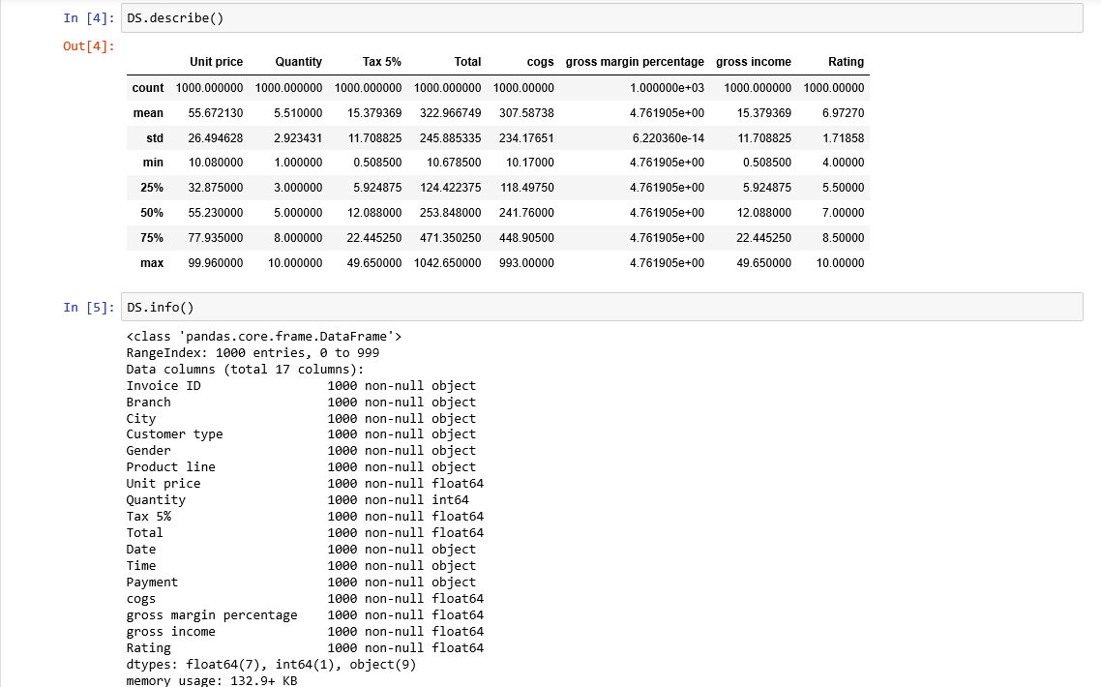
EXPLORATION OF THE DATASET

Slide 6
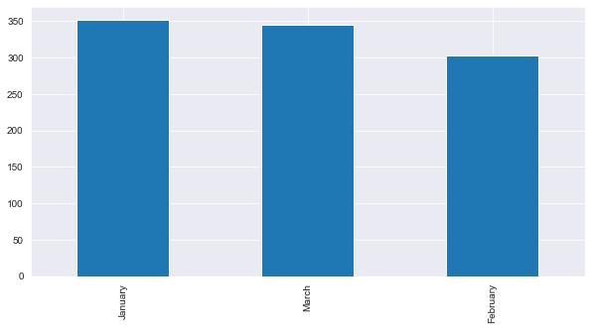
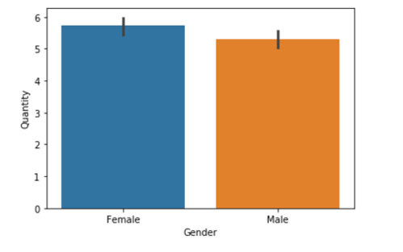
VISUALISATIONS
GENDER ANALYSIS
SALES PER MONTH

Slide 7
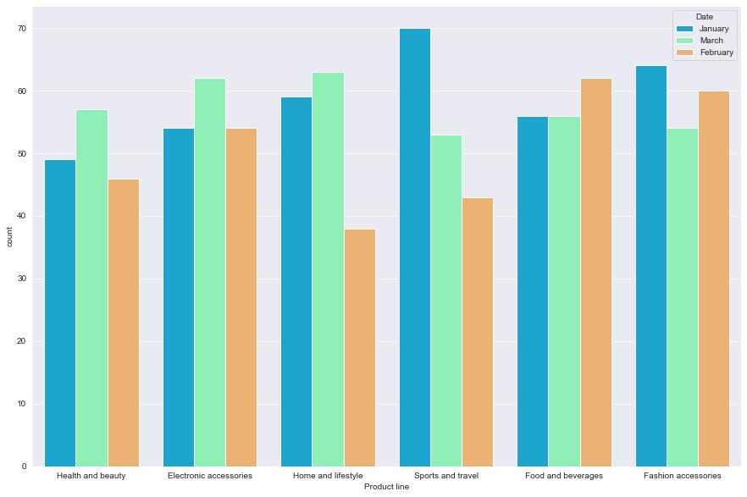
PRODUCT LINE VISUALSIZATION

Slide 8
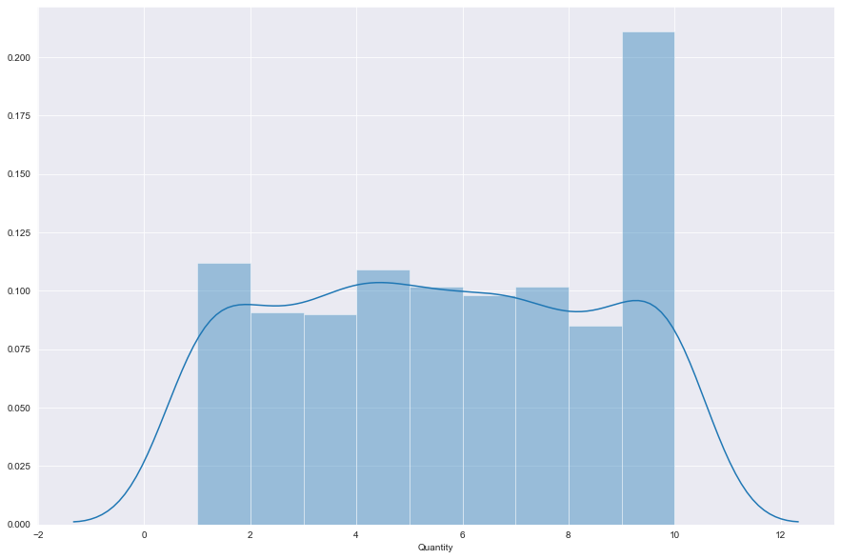
AVERAGE QUANTITY

Slide 9
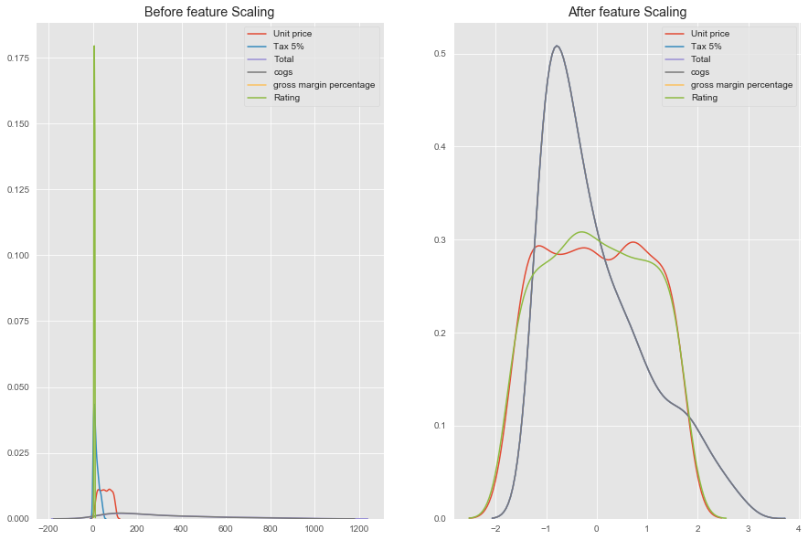
STANDARD SCALER

Slide 10
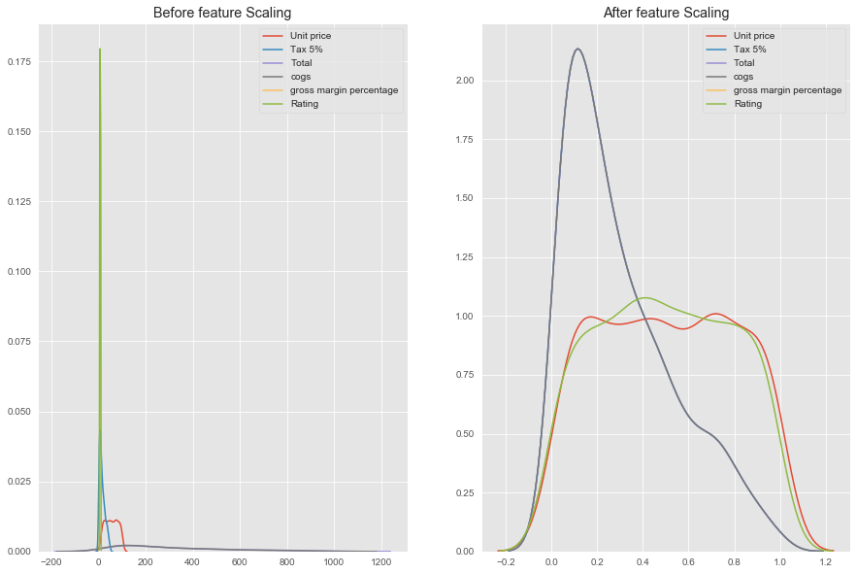
MINMAX SCALER

Slide 11
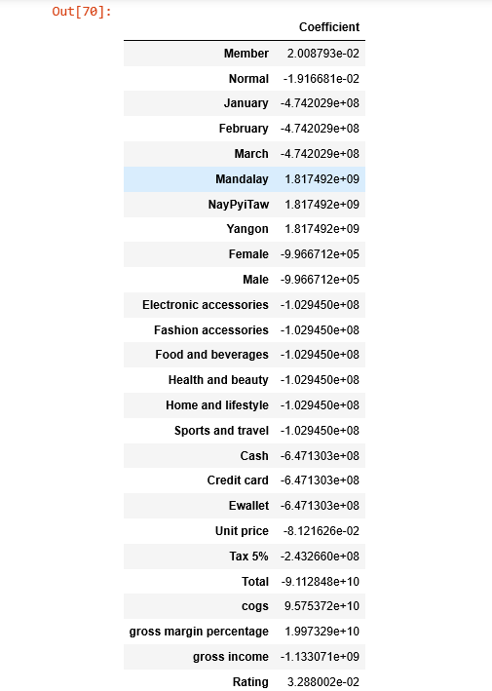
COEFFICIENTS OF ATTRIBUTES

Slide 12
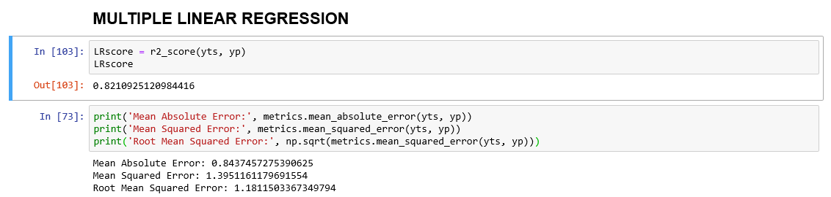
MULTIPLE LINEAR REGRESSION PERFORMANCE

Slide 13
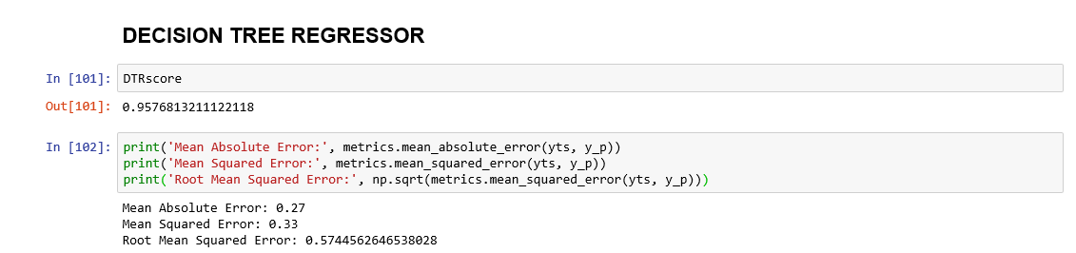
DECISION TREE REGRESSOR PERFORMANCE

Slide 14
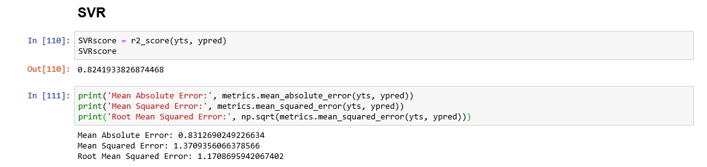
SUPPORT VECTOR REGRESSOR PERFORMANCE

Slide 15
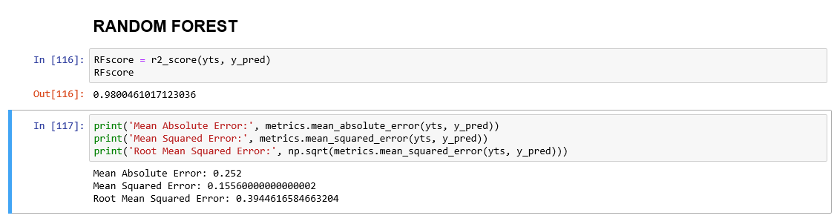
RANDOM FOREST REGRESSOR PERFORMANCE

Slide 16
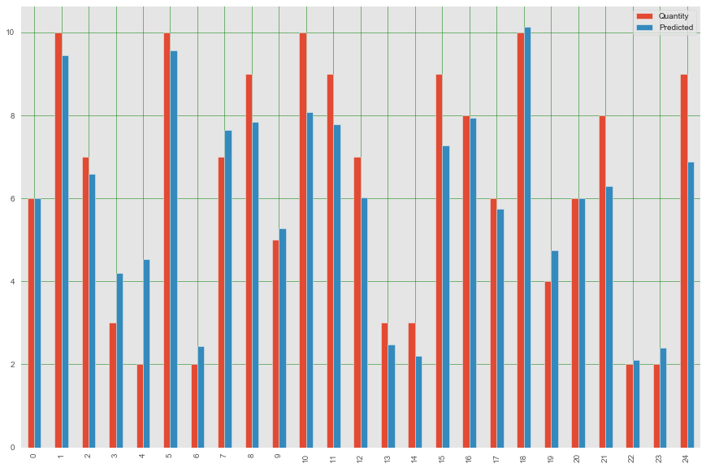
LINEAR REGRESSION MODEL

Slide 17
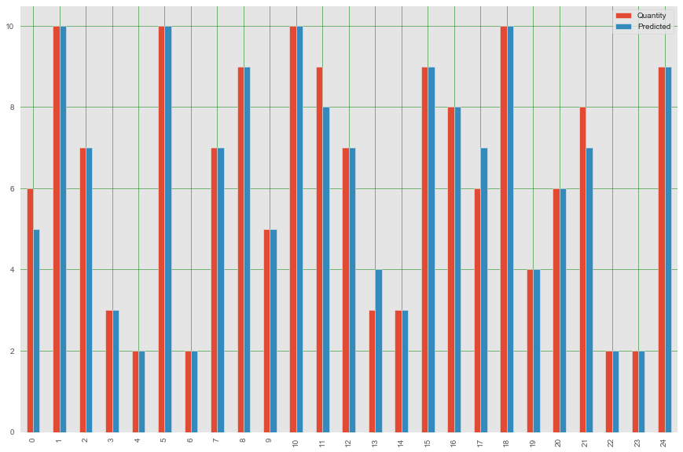
DECISION TREE REGRESSOR MODEL

Slide 18
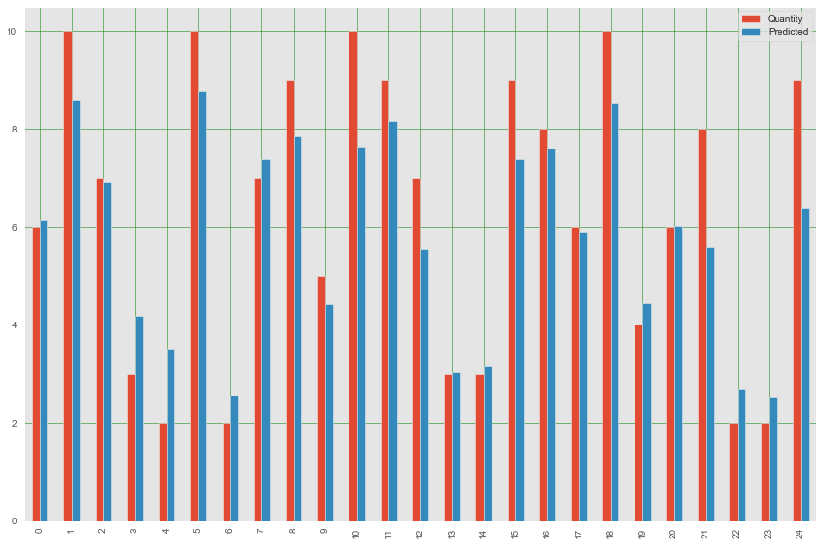
SUPPORT VECTOR REGRESSOR MODEL

Slide 19
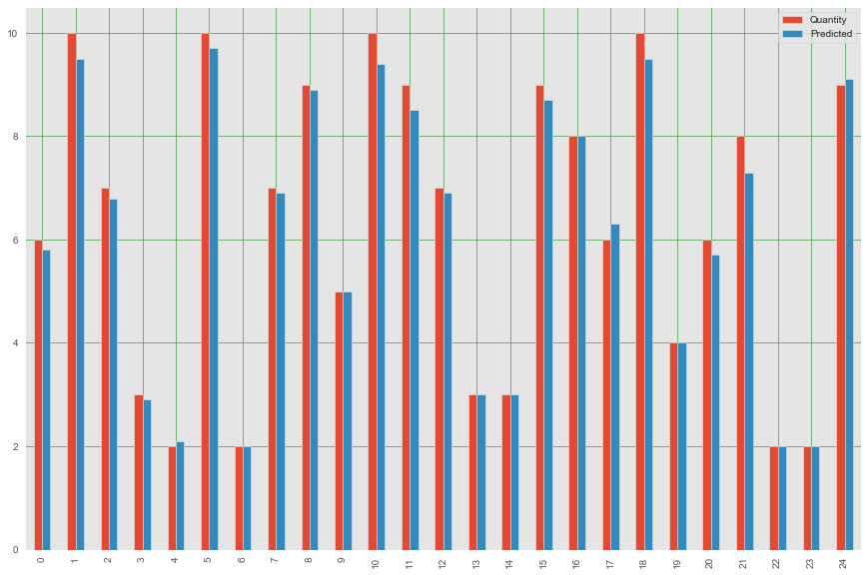
RANDOM FOREST REGRESSOR MODEL

Slide 20
CONCLUSION
The growth of supermarkets in most populated cities are increasing and market competitions are getting high hence the need for precision on the quantity of the individual product line to be stocked in First quarter of any year to avoid overstocking, expiration of goods and boost profit.
From our analysis, Random Forest Regressor Model gave the most accurate result of all the other Models.
therefore, We told Mr Bonner that We found a model that predicts the actual quantity to be stocked for every first quarter of the year considering climate change remains the same, profits remains the same. The prediction will be accurate.

Slide 21
THANK YOU

